Slide 1
Mission College
CTE

Slide 2
Graphic Design

Slide 3
Video

Slide 4
Many of you have taken….
(articulated courses that are college
compatible)
Graphic Design (GDS 035)
Web Page Design (GDS 045)
Many of you may have also taken….
(articulated courses)
Intro to Business (BUS 051)
Small Business Management (BUS 054)

Slide 5
GRAPHIC DESIGN- Pathways
Graphic Design (AS)
Graphic Design (C)
Digital Illustration (C) *
User Experience & Interface Design –
New! (C)
Web Design (C)
Web Developer (C)

Slide 6
Graphic design portfolio night

Slide 7
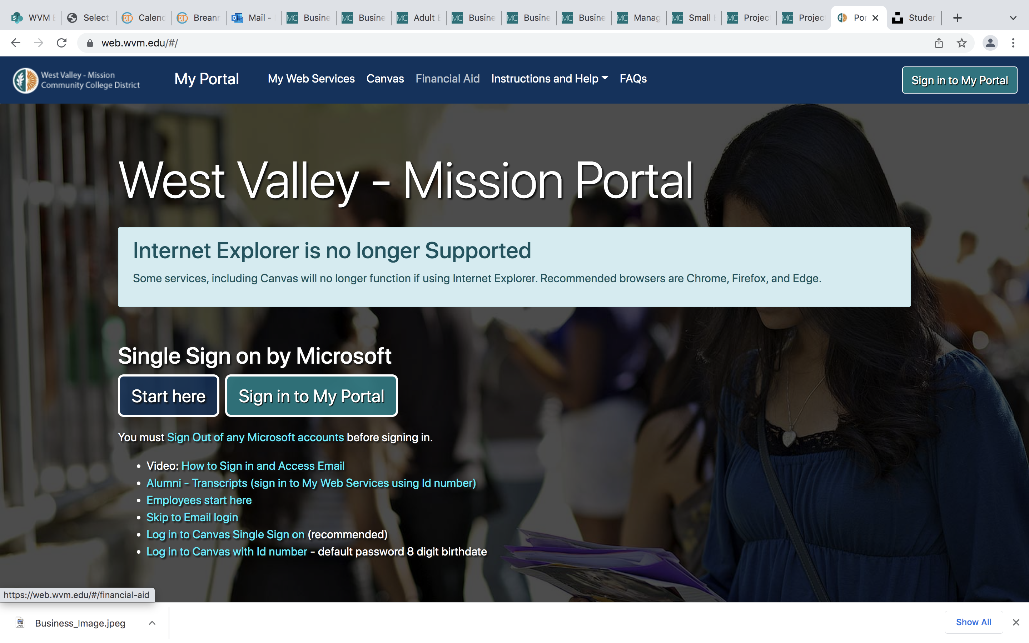
How do I CONTINUE WITH THE PATHWAY?
Check your student portal in late April for a registration date
Look for classes in the summer and fall schedule
Register
Apply for Financial Aid

Slide 8
BUSINESS- Pathways
Business (AS)
Business Administration (AS-T)
Business Administration 2.0 - NEW! (AS)
Business Computing (C)
Management and Leadership - NEW! (C)
Small Business Start-Up (C)
Project Coordinator (C)
Project Management (C) *

Slide 9
Free College- Financial Aid (1 of 2)
Mission Promise program, which provides 2 years free tuition and up to $1,000 for students REGARDLESS of need who:
Are first time college students
Enroll full-time
Submit their FAFSA or CA Dream Act Application
Are CA residents or qualify for a non-resident tuition waiver (AB 540)
So, there are multiple ways for students to get two years free tuition—we encourage all students to purse the Mission Promise program and the logistics of HOW they get the two years free tuition doesn’t really matter to them, if that makes sense.
They may get it by being CCPG eligible, they may get it thru AB 19, but that doesn’t matter too much.
They should apply for FA and strive to be eligible for Mission Promise, but if they don’t enroll full-time there is still a chance they get free tuition through CCPG.

Slide 10
Free College- Financial Aid (2 of 2)
Potentially, they might still qualify for tuition assistance if they do not qualify for the Promise Grant.
In general, we always recommend a student to file a FAFSA (for US Citizens, Permanent Residents) OR a California Dream Act CADAA (for Undocumented or DACA or U Visa) to determine eligibility and maximize the FA opportunities.
By submitting a FAFSA or CADAA the school will first look to see if they qualify for the California Community College Promise Grant (waives fees only for that year they apply).
If they want to be part of the MC Promise Program (First 2 years of Free Tuition) they must meet the following general criteria.
1)First Time College Student
2)Enroll in 12 or more (or equivalent) DSPS student can enroll in 9.
3)Submit a FAFSA/CADAA application
4)Must be a CA resident or qualify for a non-resident tuition waiver (e.g. AB540 Affidavit)
Here is the link.
https://missioncollege.edu/student_services/financial_aid/scholarships/mission-promise.html

Slide 11
Graphic Design- Occupational Demand
What the research says:
http://www.coeccc.net/Search.aspx#idDetailPanel
BLS:
https://www.bls.gov/ooh/arts-and-design/graphic-designers.htm#tab-2

Slide 12
HOW CTE ARTICULATED COURSE MEETS DEGREE OR CERTIFICATE Find your place at Mission College like Harvey did!

